Slide 1
RAPTOR Progress
Sam Kelly
RSL Slides 6/23/2015

Slide 2
RAPTOR
Rapid Three-dimensional Orientation Resolver (RAPTOR)
Uses man-made, textured, high-quality 3D models of rigid tactical objects (ships, planes, weapons, etc.) to generate “training” data
Goal is to determine with a great degree of accuracy the 3D orientation and position of pre-labeled, pre-localized instances of these objects in 2D images
Object class is already known
Already have a bounding box
Need to find the 3D orientation as a unit quaternion (e.g. {1.0, 0.5, 0.32, 0.7})
Once orientation is found, distance from camera and 3D position are trivial to calculate
Will eventually need to deal with background noise

Slide 3
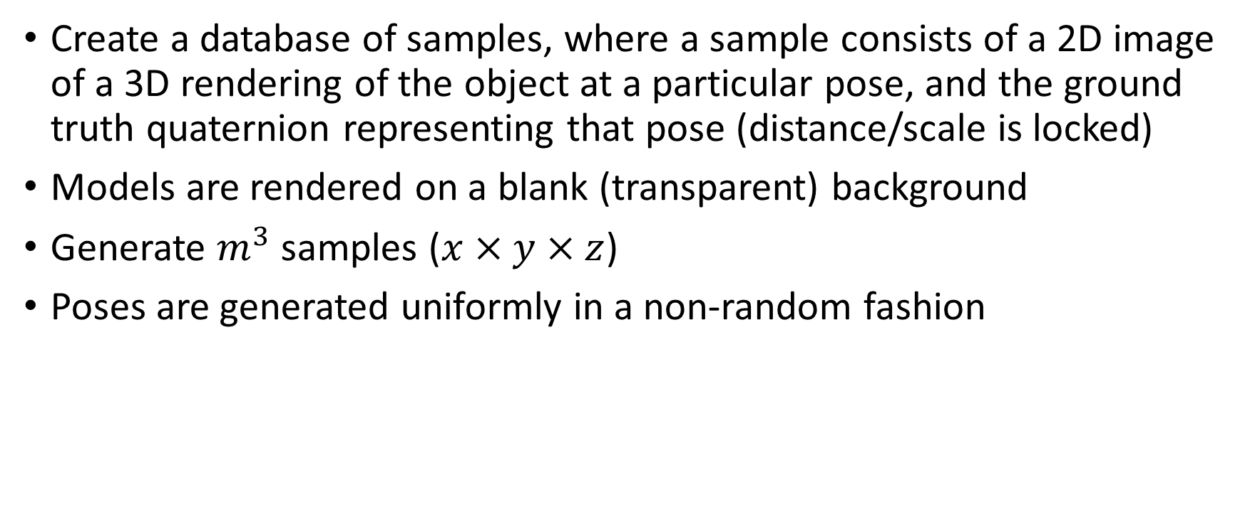
Data Generation
Create a database of samples, where a sample consists of a 2D image of a 3D rendering of the object at a particular pose, and the ground truth quaternion representing that pose (distance/scale is locked)
Models are rendered on a blank (transparent) background
Generate $m^{3}$ samples ($x×y×z$)
Poses are generated uniformly in a non-random fashion

Slide 4
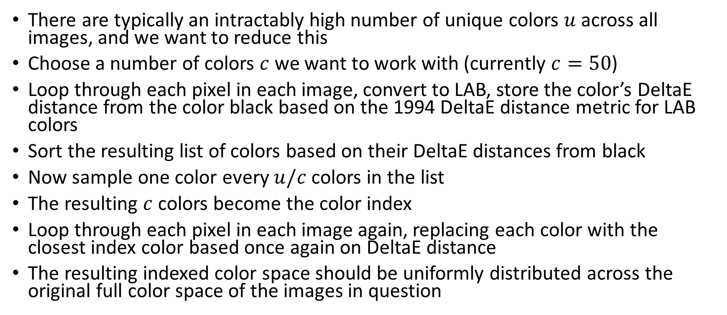
Color Space Reduction
There are typically an intractably high number of unique colors $u$ across all images, and we want to reduce this
Choose a number of colors $c$ we want to work with (currently $c=50$)
Loop through each pixel in each image, convert to LAB, store the color’s DeltaE distance from the color black based on the 1994 DeltaE distance metric for LAB colors
Sort the resulting list of colors based on their DeltaE distances from black
Now sample one color every $u/c$ colors in the list
The resulting $c$ colors become the color index
Loop through each pixel in each image again, replacing each color with the closest index color based once again on DeltaE distance
The resulting indexed color space should be uniformly distributed across the original full color space of the images in question

Slide 5
Collecting Per-Pixel Pose Information
Extremely simplified pseudocode:
for each (image : orientation) pair
for each image pixel
c = indexed version of pixel color
add orientation to grid[pixel.x][pixel.y][c]
end
end

Slide 6
Identifying an Orientation
For each pixel in the query image
Convert to indexed color
Keep count of each orientation that shows up at that pixel location in the grid
Sum these orientation counts across all pixels
Sort by the number of orientation occurrences
The more occurrences, the closer the match

Slide 7
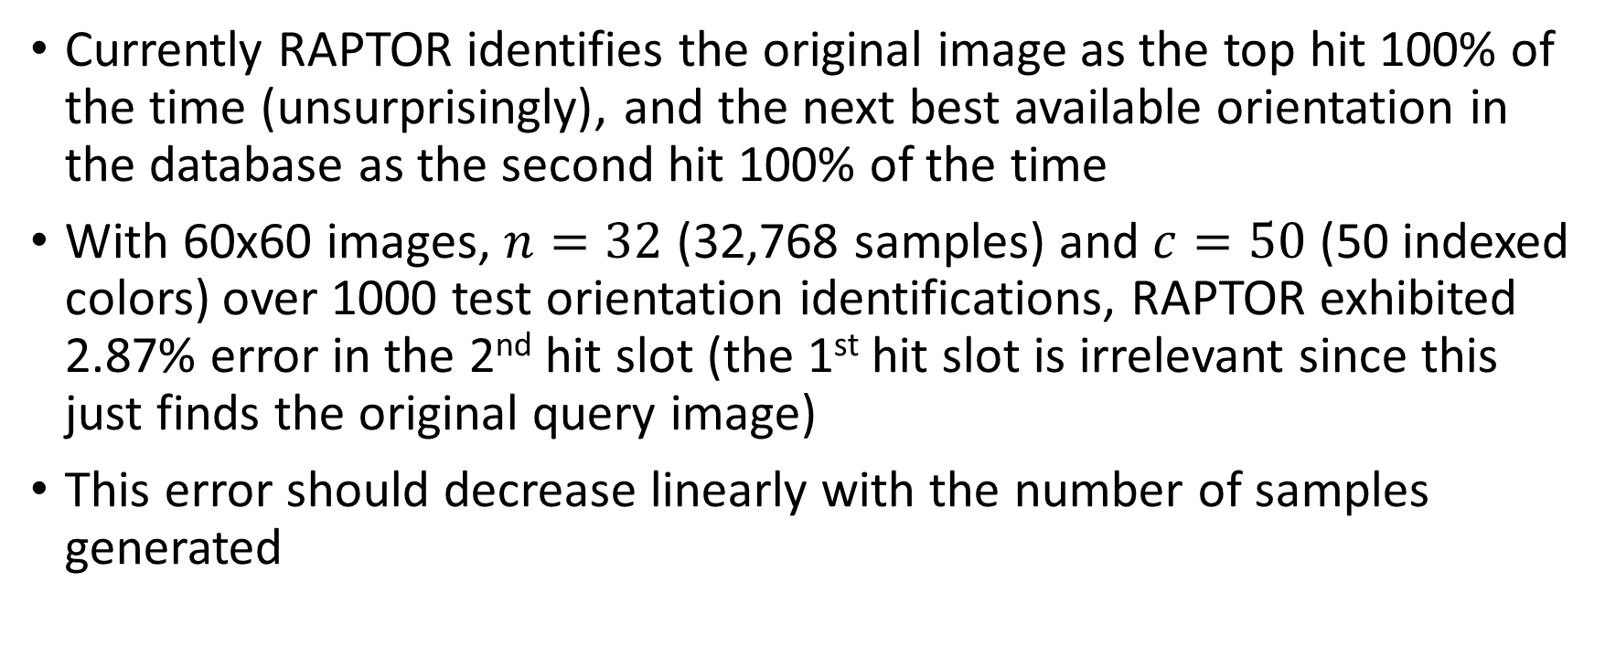
Current Results
Currently RAPTOR identifies the original image as the top hit 100% of the time (unsurprisingly), and the next best available orientation in the database as the second hit 100% of the time
With 60x60 images, $n=32$ (32,768 samples) and $c=50$ (50 indexed colors) over 1000 test orientation identifications, RAPTOR exhibited 2.87% error in the 2nd hit slot (the 1st hit slot is irrelevant since this just finds the original query image)
This error should decrease linearly with the number of samples generated

Slide 8
Future Work
Need to place this work within the existing literature on pose estimation (baseline should be FFTs)
Test on a larger variety of object classes and hyper-parameter configurations
Use interpolation to improve accuracy
Lay groundwork for removing background noise
Test on real world images
Deal with bounding boxes
Output 3D position as well as orientation

